Slide 1
Prudential NICE Archive
Clifford Grimm
June 16, 2014

Slide 2
Agenda
Problem Description
Solution Overview
Solution Delivery
Engagement Topics

Slide 3
Problem Description

Slide 4
Problem
Approximately 16TB of NICE call data stored on USB drives
Combination of WAV and AUD files
Originally archived onto Tape
Moved to USB Drives with metadata available in various forms
Stored off-line in vault
Drives are failing and search for calls is difficult (i.e. impossible)
Need safe long-term storage with quick search capabilities

Slide 5
Solution Overview

Slide 6
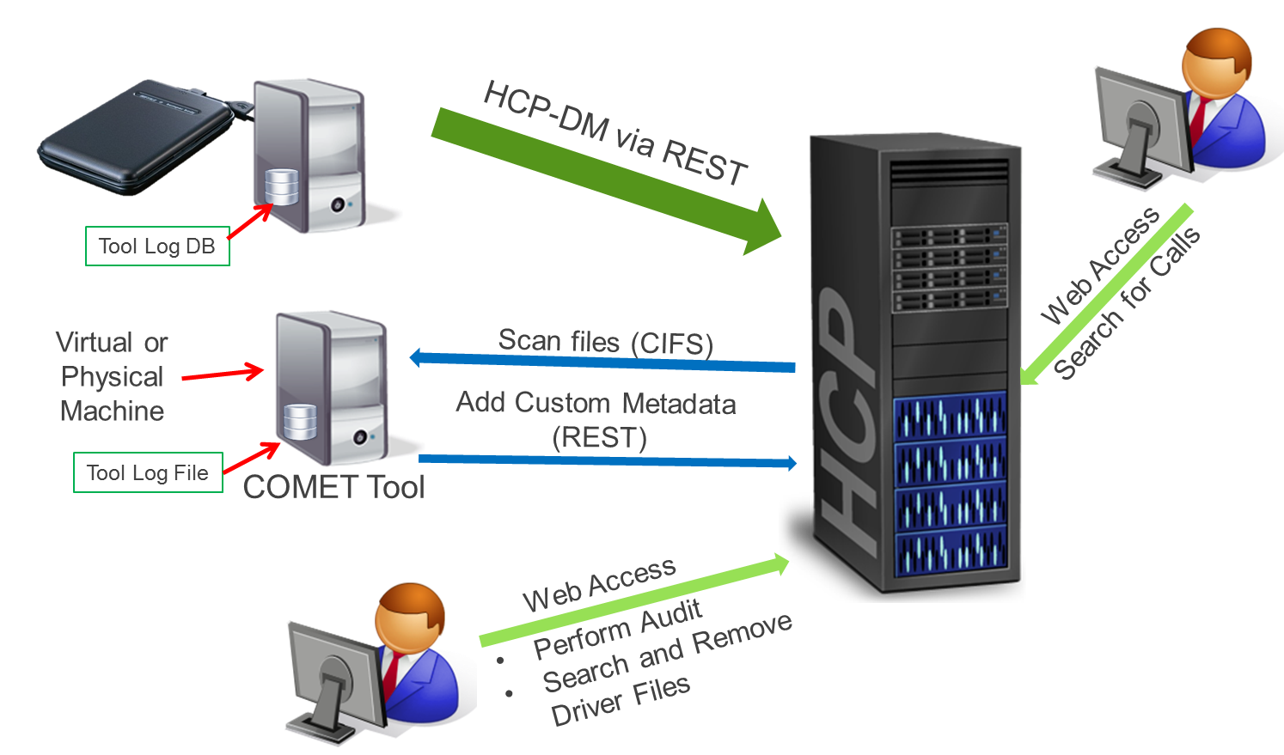
Data Flow Diagram

Slide 7
Solution Notes
Prudential to move content off of USB drives directly to HCP
Drives are fragile and need them off fast
HDS developed solution
Add Custom Metadata to each call recording to enable search
Deploy and monitor to completion
Provide Training on search via HCP Search Console
Audit content to provide summary of engagement

Slide 8
Custom Metadata on Each Recording
<CallRecording type=”Aud|wav”>
<Logger>#######</Logger>
<Channel>######</Channel>
<Server>####</Server>
<Session>#####</Session>
<CLSCallID>####</CLSCallID>
<AgentID>####</AgentID>
<DateTime>
<Start>yyyy-MM-ddTHH:mm:ssZ</Start>
<End>yyyy-MM-ddTHH:mm:ssZ</End>
<DateTime>
</CallRecording>
Most important fields:
AgentID, Logger, Start/End Times

Slide 9
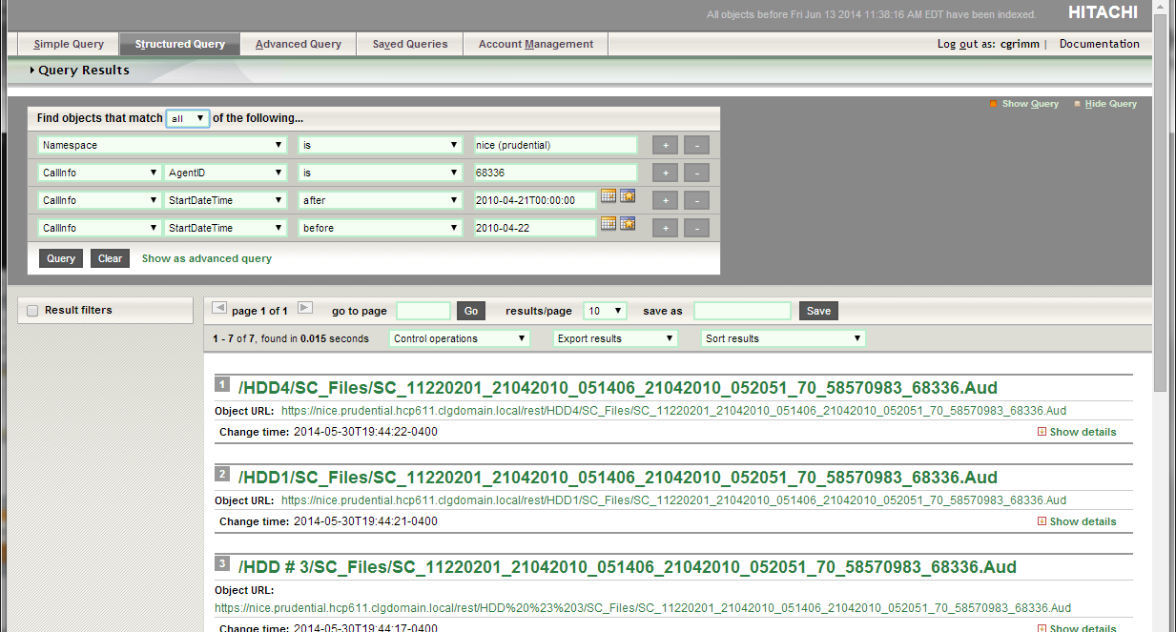
Sample Search

Slide 10
Solution Delivery

Slide 11
Solution Delivery Overview
Data Analysis
Create COMET Modules
Site Visit to Deploy
Off-Site Monitoring of Progress

Slide 12
Data Analysis – How to get metadata
Given recursive folder listing and few sample “driver” metadata files
Find patterns in generating custom metadata
Most files, metadata embedded in file name
Others have “driver” mapping files somewhere in the folder structure
Must lookup filename in “driver” file to get metadata
Not all fields are available for all file types.

Slide 13
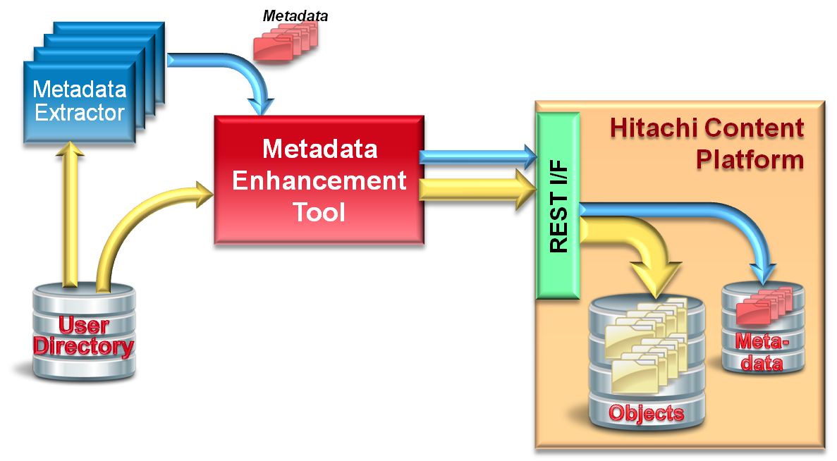
COMET Modules
What is COMET?
Customizable Object Metadata Enhancement Tool
Multi-platform (written in Java)
PS usable engine to ingest content with generated metadata
Both System and Custom Metadata
Can be used for one-time and continuous data ingestion
Pluggable architecture for customer specific metadata generation

Slide 14
COMET Modules
Code COMET modules to ingest custom metadata
Create 6 different modules based on the patterns discovered
Read from file name.
Hunt down from text files at various locations
Tested with
Regenerated file structure
Wav/Aud files downloaded from internet

Slide 15
Site Visit to Deploy
Site Preparations
System to run COMET
Windows VDI available system
Can reach HCP
HCP Namespace mapped to drives
One for each node for addressing throughput
E-mail coordination only approved way to get software on system
Setup as contractor for approved access to relevant systems

Slide 16
Site Visit to Deploy
Deployment at Customer
Customer used HCP-DM to move recordings
Needed it done immediately as drives were failing
Install COMET and modules
Run multiple instances for best throughput
Demo search using HCP Search Console

Slide 17
Off-Site Monitoring
VPN Access and connecting to Windows VDI session
Monitor Daily
Observe progress
Validate data
Tweak for better throughput
Prepare conclusion report
Identify call recordings missing metadata
Categorize availability of each metadata value on data set

Slide 18
Engagement Topics

Slide 19
Take-aways
Large Company Attributes
Very Compartmentalized and/or fragmented knowledge
Can’t tell who is in charge
Frequent resistance of what/how one can and can’t do
Legal Logistics
Privacy, confidentiality, etc.
Delivery Logistics
Need VPN/Remote Access to infrastructure for monitoring
Coordinating WebEx access is far to difficult to coordinate
Systems locked down from any outward or inward network activity
Must try to anticipate all software needed and provide ahead of time
Little knowledge of their own data
Found lots of missing calls and metadata

Slide 20
Questions and Discussion

Slide 21
Thank You

